Slide 1
DETERMINATION OF GENUINENESS OF A MEDICAL PROFESSIONAL
Prepared by:
Aayush Shah (SAP: 60004140091)
Pranay Shah (SAP: 60004140101)
Dipam Vasani (SAP: 60004140116)

Slide 2
MOTIVATION
To protect a patient’s privacy in a hospital management system. Example
Prevent mediclaim information from being leaked to insurance agencies.
Prevent patient’s sensitive information such as mental illness, abortion or HIV status from being leaked without consent.
Spotting out unqualified practitioners or ‘quacks’ who may further complicate an illness instead of curing it.
Prevent doctors from performing unnecessary surgeries.
Existing solutions inadequate and inaccurate.

Slide 3
LITERATURE REVIEW
REFERENCE PAPER | MODEL | DRAWBACKS
Quantified Risk-Adaptive Access Control for Patient Privacy Protection in Health Information Systems | A risk based adaptive model to keep a check on the data consumed by information consumers. | The system is less accurate and considers only one parameter i.e. relevance of data accessed.
Clustering-based Analysis in Hospital Information Systems | A clustering based algorithm to group orders based on various identified attributes | Clustering may lead to a lot of fake orders forming a cluster.

Slide 4
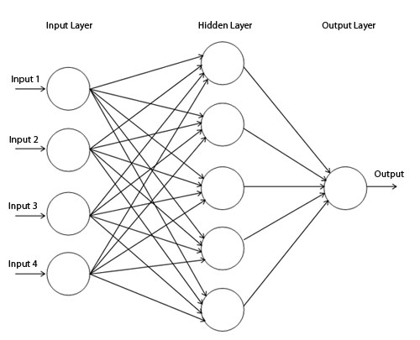
OUR MODEL
Supervised Neural network.
5 parameters as input.
1 output between 0 and 1.
Output compared with threshold to determine whether a doctor is ‘genuine’ or ‘malicious’.
Trained via error backpropogation.
Intricate Knowledge base defined for training phase

Slide 5
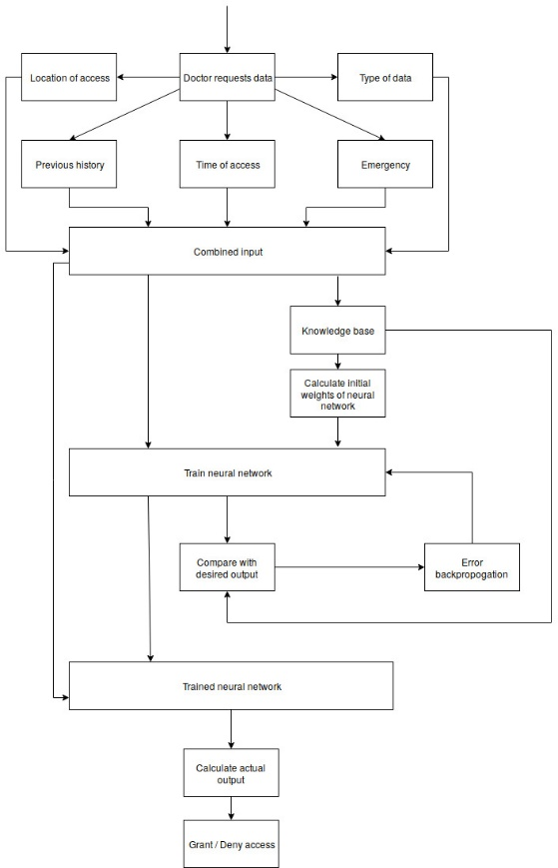
FLOWCHART
Doctor requests data.
Parameters captured and combined to form input to a neural network.
For training phase a Knowledge base determines desired output and initial neural weights.
Trained using error back propogation technique.
After training phase - actual output of the data is calculated.
Output compared with predefined threshold. Access denied to malicious doctors

Slide 6
ADVANTAGES OF OUR MODEL
Provisions for emergency/special cases are taken in the model.
Previous access history of a doctor taken into account.
Intricate rule base that determines the initial weights of the neural network and its desired output based on 5 different input parameters.
High accuracy as a large number of examples will be used for training via error backpropogation technique.
Time efficient once training phase is completed.

Slide 7
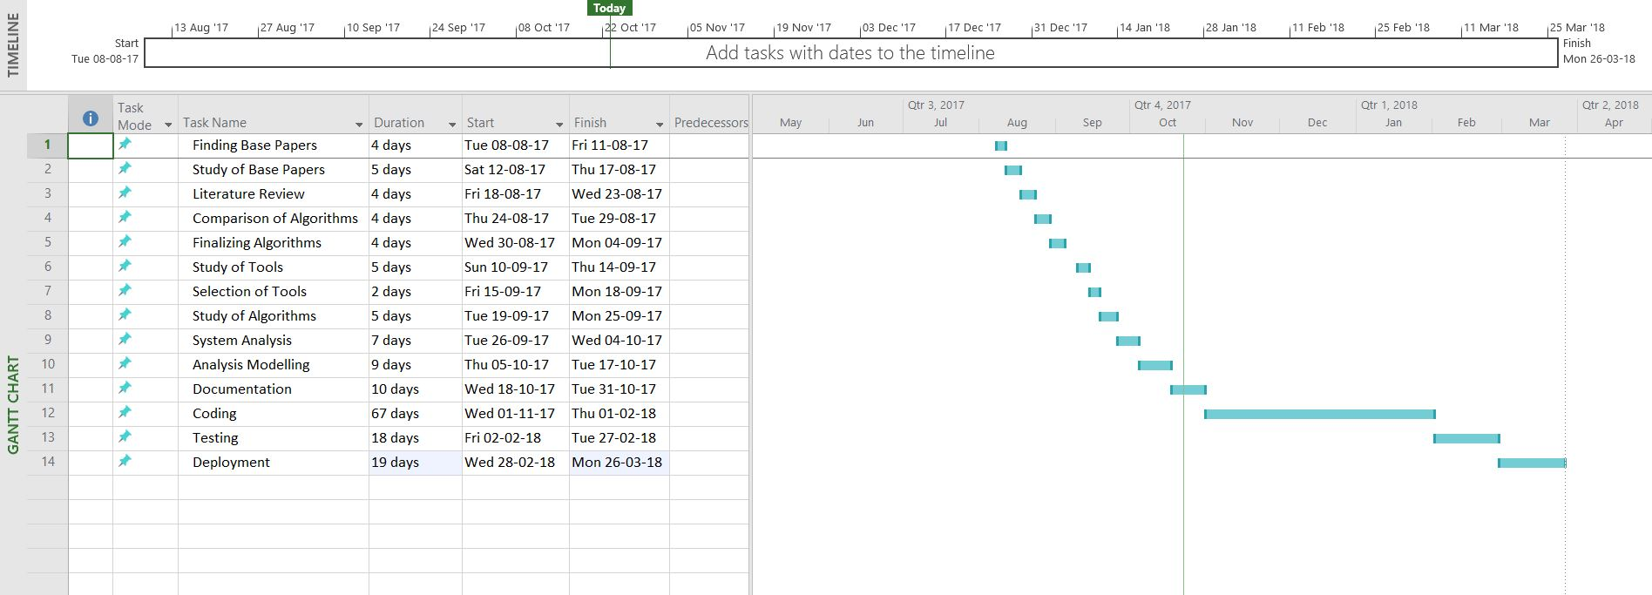
SCHEDULE FOLLOWED

Slide 8
Thank you!

